Slide 1
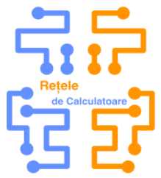
Protocol Layers
Lab1

Slide 2
Cuprins
Probleme organizatorice
Retele de calculatoare – De ce?
Niveluri de comunicatii
Wireshark
Lab work

Slide 3
Probleme organizatorice
Prezenta – lucrarile de laborator trebuie efectuate
Se poate veni cu orice grupa
  Luni 16:20-19:30
  Miercuri ?
Notare: 2 teste de laborator

Slide 4
Retele de calculatoare – De ce?
Comunicare – Emitator - Receptor
Evolution of web
Moduri de comunicare
Unicast
Multicast
Broadcast

Slide 5
Retele de calculatoare – Cum comunicam?
Exemple de topologii de comunicare
Point to point
Star
Bus
Mesh
Ring

Slide 6
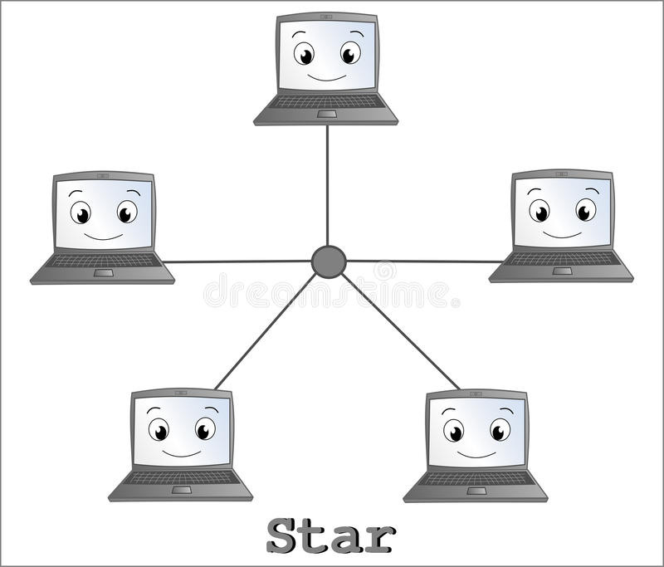
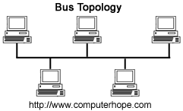
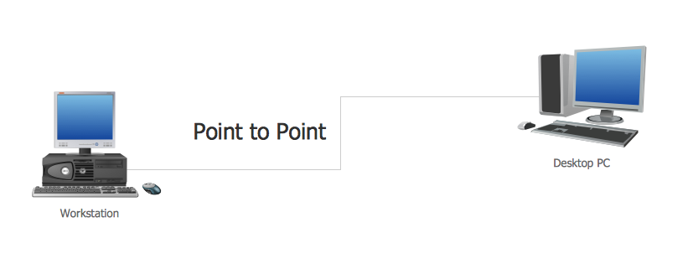
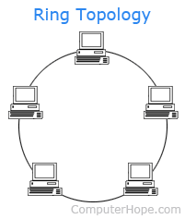
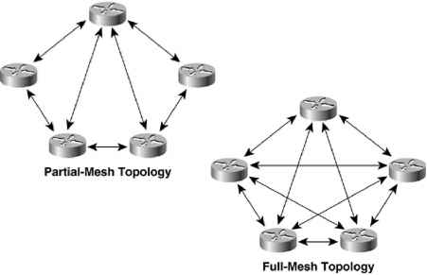
Retele de calculatoare – De ce?
Exemple de topologii de comunicare
Point to point
Star
Bus
Mesh
Ring

Slide 7
Niveluri de comunicatii
 | OSI Model | TCP/IP Model
Data | Application (aplicatii) | Application
 | Session ( criptarea datelor)
 | Prezentation ( comunicare intre gazde)
Segments | Transport (conexiune end-to-end) | Transport
Packets | Network(Ip si determinarea cai ) | Internet
Frames | Data Link (Adresare fizica) | Network Access / Link
Bits | Physical (mediul de transmisie)

Slide 8

Wireshark
Tutoriale:
https://www.youtube.com/watch?v=TkCSr30UojM
https://www.concise-courses.com/security/wireshark-basics/
https://www.wireshark.org/

Slide 9

Lab work
Let’s start a trace and see what happens

